Slide 1
Reliable-Vs-Unreliable-primitives
Lecture-09

Slide 2
Reliable-Vs-Unreliable-primitives
During the transmission of the message from the sender to the receiver, the message may get lost, which affects the semantics of the message passing model.
Three different approaches to this problem are possible:
The first one is to assume that the send primitive is unreliable. The system gives no gurantee about messages being delivered.
The second approach is to require kernel on the receiving machine to send an acknowledgement back to the kernel on the sending machine.
Only when the acknowledgement is received, the sending kernel free the user (client) process.
The acknowledgement goes from kernel to kernel.
Thus a request and reply now take 4 messages, as shown by the figure in the next slide.

Slide 3
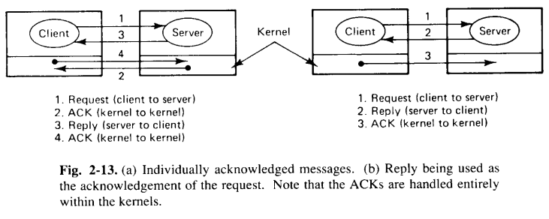
Cont..

Slide 4
Cont..
In the third approach, the client is blocked after sending a message.
The server’s kernel does not send back an acknowledgement. Instead, the reply itself acts as an acknowledgement. Thus, the sender remains blocked until the reply comes in.
If the reply takes too long, the sending kernel can resend the request to guard against the possibility of a lost message.
This approach is shown in Figure 2-13(b).

Slide 5
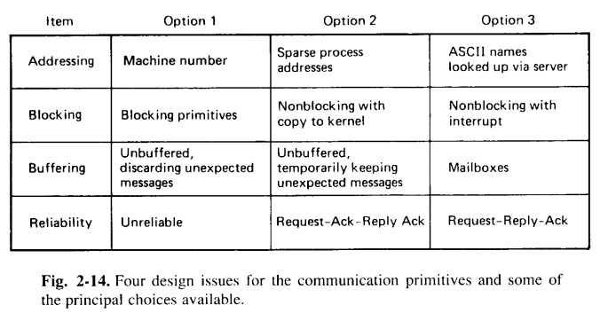
Implementing the Client-Server model
Design issues alternatives are:

Slide 6
Cont..
All networks have a maximum packet size. Messages larger than this size must be split up into multiple packets and send separately.
Some of these packets may be lost, and they may even arrive in wrong order.
To deal with this problem, it is usually sufficient to assign a message number to each message, and put it in each packet belonging to the message, along with the sequence number giving the order of the packets.
To deal with these issues, an acknowledgement mechanism must be used.
One way is to acknowledge each packet individually.
This scheme has the advantage that if a packet is lost, only that packet is to be retransmitted, but it has disadvantage of having more packets in the network.
Another strategy is to acknowledge only entire message.
It has the advantage of fewer packets, but the disadvantage of more complicated recovery, if a packet is lost.

Slide 7
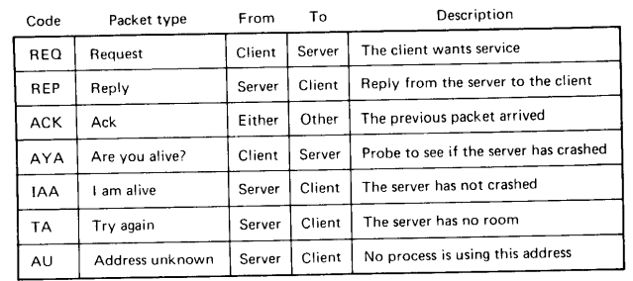
Cont..
Another issue is the underlying protocol used in the client-server communication.
Table below shows six packet types that are commonly used to implement client-server protocol.

Slide 8
Cont..
REQ packet: used to send a request message from a client to a server.
REP packet: used to carry result back from server to the client.
ACK packet: used in reliable protocols to confirm the correct receipt of the previous packet.
AYA packet: used to get the status of the server.
IAA packet: it tells the client that the server has not crashed and is currently processing the client’s request.
The last two packet types i.e., TA and AU are useful in case a REQ packet cannot be accepted.
TA packet: is used by the server kernel to the client kernel that the address is valid and the request should be repeated later (as the server’s process mailbox is full).
AU packet: it indicates that the address does not belongs to any process or mailbox.

